Slide 1



Developer Project
Timothy Owen

Slide 2
Key Technologies
Declarative Features
Apex
Visualforce

Slide 3

Code | Title
ADX201 | Admin Essentials for new Admins
ADX211 | Admin Essentials for Experienced Admins
DEX403 | Declarative Development for Platform App Builders
ADX231 | Introduction to Apex & Object Oriented Programming
DEX450 | Programmatic Development with Apex & Visualforce

Slide 4
Introduction
= Reports to
CEO
Training Coordinator
Billing Administrator
Instructor
Instructor
Instructor

Slide 5
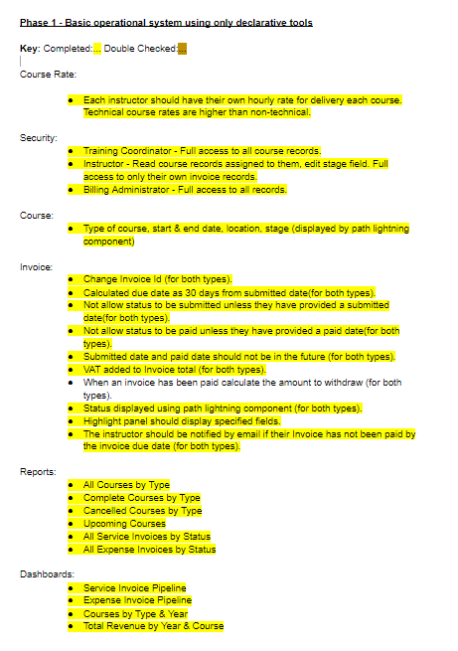
Phase 1 Requirements

Slide 6
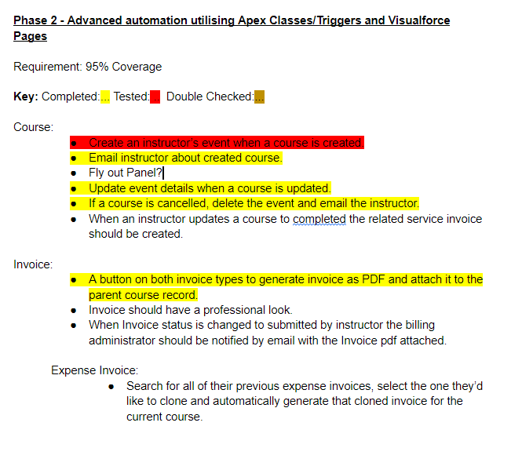
Phase 2 Requirements

Slide 7
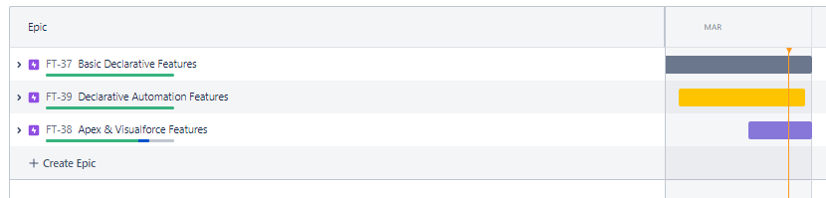
Project Management Board
https://towen.atlassian.net/jira/software/c/projects/FT/boards

Slide 8
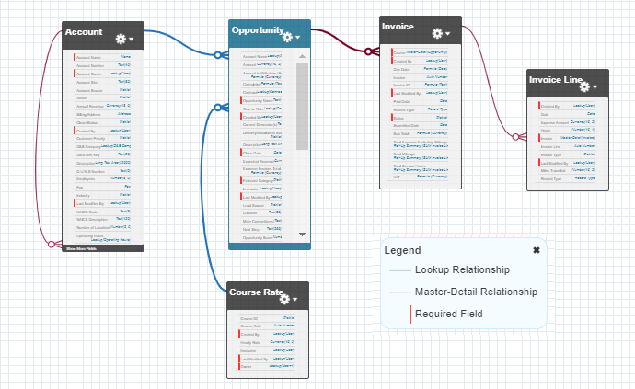
Structure of Org

Slide 9
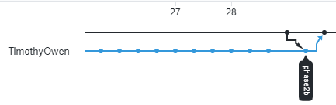
Version Control System
Deployment

Slide 10
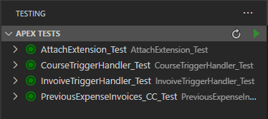
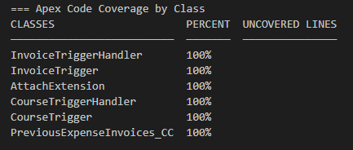

Unit Testing

Slide 11
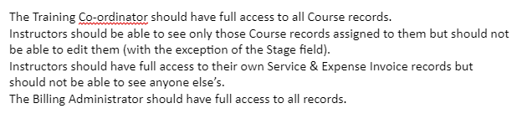
Security
Profiles
Sharing Settings
Role Hierarchy
Apex Sharing

Slide 12
Demo

Slide 13
Future Improvements
CEO
Senior Training Coordinator
Billing Administrator
Training Coordinator
Training Coordinator
Instructor
Instructor
Instructor
Instructor
Instructor
Instructor

Slide 14

Future Improvements

Slide 15

Future Improvements

Slide 16
Thank you for listening
Any questions?
Timothy Owen

